Slide 1
Machine Learning “Image Detection” Week IV
Lecturer : Mr. Hel Chanthan
Student : Chek Nita

Slide 2
Planning
Week I
Introducing to Machine Learning
Done
Week II
Machine Learning Techniques
Done
Week III
Lab
Done
Week IV
Own Project
In Progressing

Slide 3
Planning For October
October 2020 | Week I | Week II | Week III | Week III
Monday | Preparing & Researching Lab | Trying out some ML techniques | Figure out some formulars | Doing more Research
Tuesday | Preparing & Researching Lab | Preparing about researching | Focus on own project | Testing works
Wednesday | Done Research Lab | Practice code | Use ML to test | Complete works
Thursday | Presentation | Presentation | Presentation | Presentation
Friday | Research about Image Detection | Testing | Improving works | Review works
Saturday | Rewriting Code | Researching | Recoding | Make sure to Finish
Sunday | Practice | Collect Data | Research | Making Report

Slide 4
Outline
What is Image-Detection ?
Why it is related to Machine Learning ?
Testing code
Python Library usage
Further Plan

Slide 5
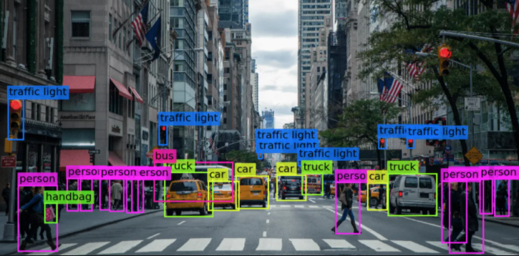
Image Detection
What is Image-Detection ?
Image recognition, in the context of machine vision, is the ability of software to identify objects, places, people, writing and actions in images. Computers can use machine vision technologies in combination with a camera and artificial intelligence software to achieve image recognition.

Slide 6
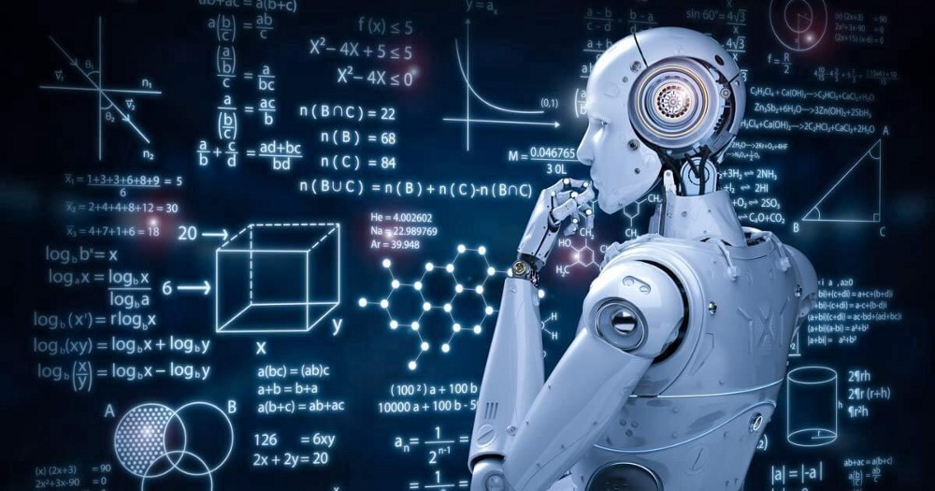
Image Detection
Why it is related to ML?
Image recognition is used to perform a large number of machine-based visual tasks, such as labeling the content of images with meta-tags, performing image content search and guiding autonomous robots, self-driving cars and accident avoidance systems.

Slide 7
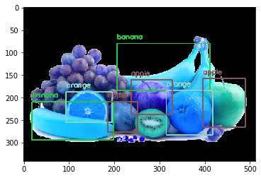
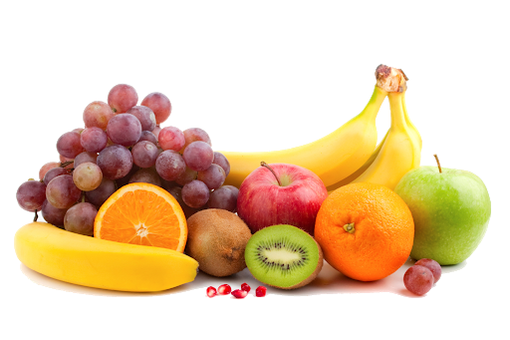
Image Detection Example
Before
After
https://github.com/arunponnusamy/object-detection-opencv

Slide 8
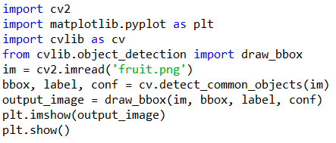
Image Detection Example

Slide 9
Python Library Usages
Open Cv ( Open Computer Vision )
Matplotlib
Numpy
Cvlib
Yolo
Data resource : Using COCO (Microsoft Data set) that being trained and recognized 80 objects only

Slide 10
Future Plan & Difficulty
Future Plan
Using more dataset to test about image detection
Using these as reference to improve more about image-detection
Difficulty
A little bit hard to understand code
Need more times to study and research

Slide 11
Thank You !!!

